Slide 1
VIZ1, Session 1
Introduction

Slide 2
Ole Ildsgaard Hougaard
oih@via.dk
Computer Scientist (PhD)
Programming languages
Type systems
Industry experience
Uni-C
Educational Software, Games
Senior Developer
Acure / IBM
Healthcare solutions
Developer, architect, Scrum master
Google
V8 JavaScript Engine
VIA since 2009

Slide 3
Agenda
Introducing the course
Introducing visualization
Introducing SVG
Introducing D3.js

Slide 4
Agenda
Introducing the course
Introducing visualization
Introducing SVG
Introducing D3.js

Slide 5
VIZ1
2 main topics:
Designing visualizations based on data and use case
Implementing the visualization
Teaching elements
Theory
Exercises
Hand-ins
Sources
Tamara Munzner: "Visualization - Analysis & Design"
Online resources (mostly for D3.js)

Slide 6
The formalities
3 hand-ins (mandatory)
Implementing non-interactive visualizations in D3.js Start: next week Hand-in: 27 September
Implementing interactive visualizations in D3.js and React Start: 28 September Hand-in: 25 October
Analyse, design and implement your own visualizations in D3.js and React Start: 26 October Presentation: 23 November
Exam is oral based on one of the hand-ins (MAL1 style)

Slide 7
Generative AI
The recommended use of GAI in this course is for reviewing your work only
To actually learn visualization, you will need to
Get your own ideas
Evaluate designs
Fiddle with the code to get the output just right

Slide 8
Agenda
Introducing the course
Introducing visualization
Introducing SVG
Introducing D3.js

Slide 9
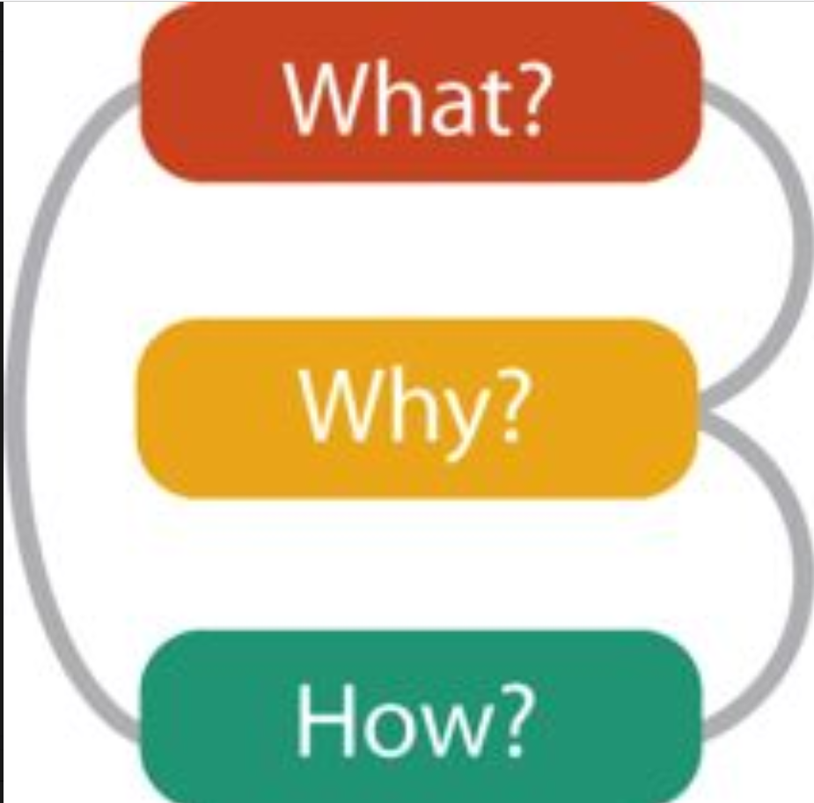
The what, the why, and the how (Munzner)

Slide 10
The what, the why, and the how (Munzner)
The what - data
The types of data
The semantics of data
The why - purpose
The intended actions
The intended targets
The how - visualizations
Marks
Channels

Slide 11
Marks and Channels
Marks - the base shapes
0D: points
1D: lines
2D: areas
3D: volumes (rarely)
Channels - how the shapes are presented
position
size
colour
shape

Slide 12
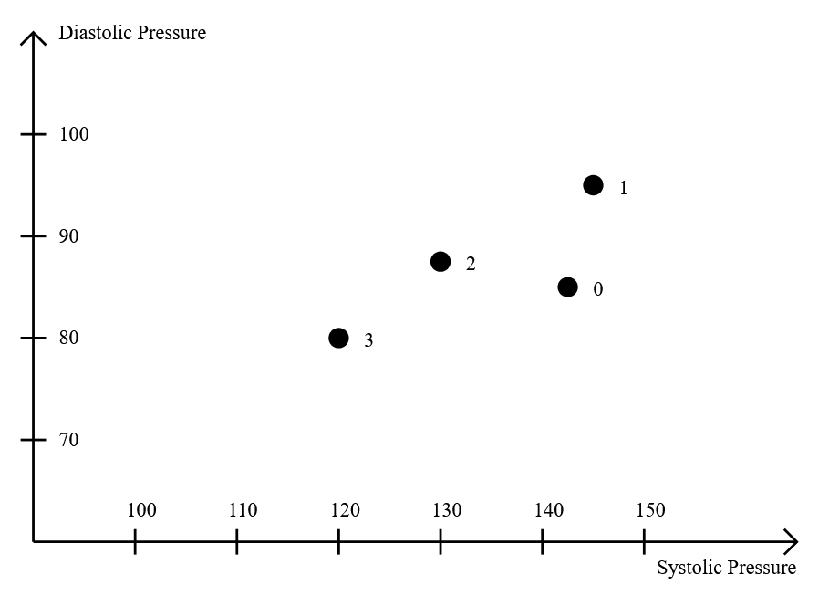
Example: Blood pressure of hospital patients by day (reconstructed)

Slide 13
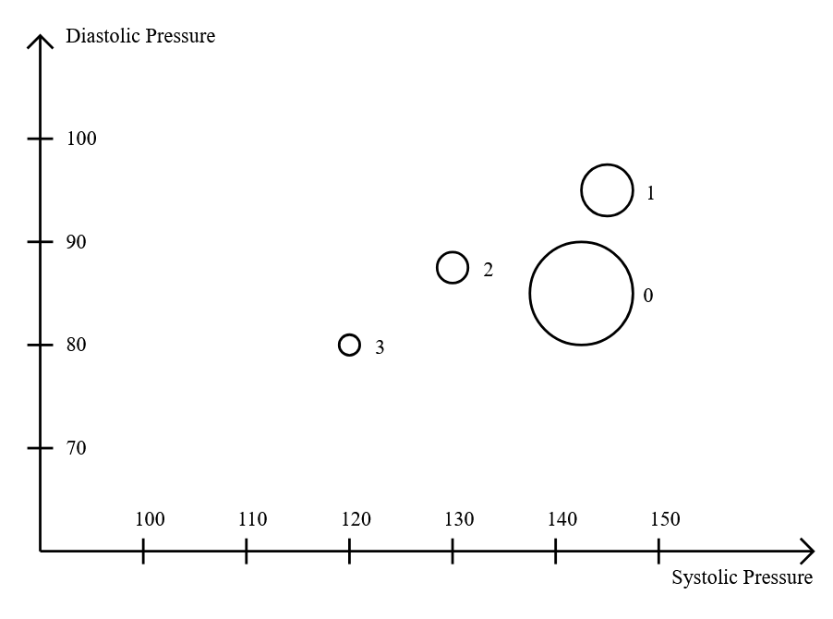
Example continued: Number of patients

Slide 14
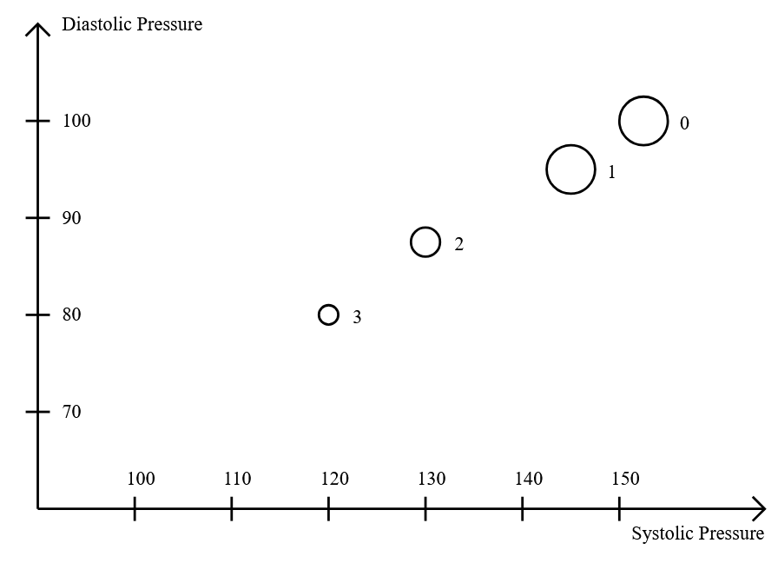
Example continued: Filtering only overnight patients

Slide 15
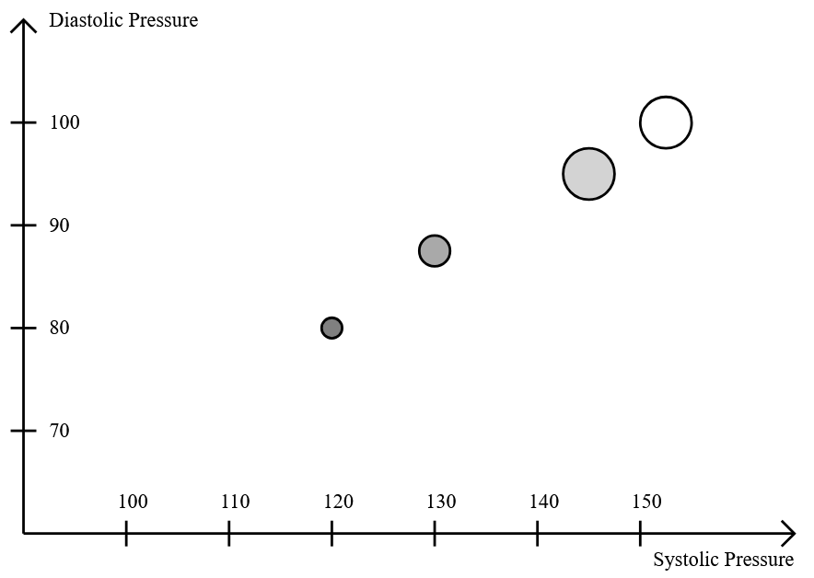
Example continued: 4 channels

Slide 16
Agenda
Introducing the course
Introducing visualization
Introducing SVG
Introducing D3.js

Slide 17
Scalable Vector Graphics (SVG)
What is it?
Has points, directions, … instead of pixels
Vectors
Paths
Doesn't depend on resolution - scalable
Shapes
Text

Slide 18
Scalable Vector Graphics (SVG)
Why/when to use it?
Why/when not to use it?
Doesn't depend on resolution
Scalable
Icons - Simple
Illustrations
Diagrams
Photographs
Lose information
Bigger files

Slide 19
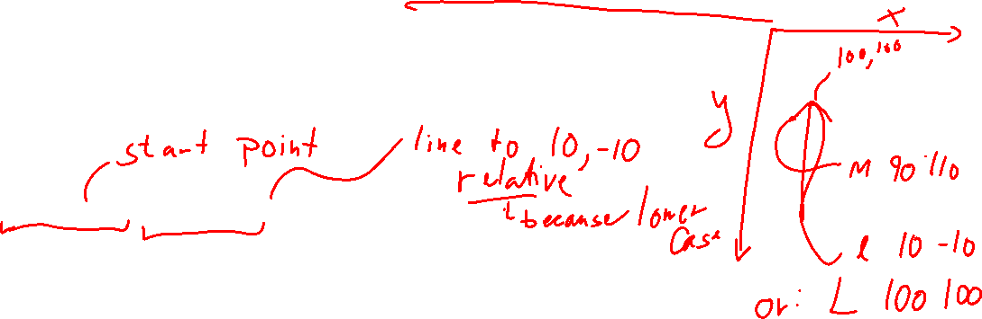
Example
<line
x1="100" y1="500" x2="700" y2="500"
stroke="black" stroke-width="2"/>
<path
d="M 90 110 l 10 -10 l 10 10"
fill="none" stroke="black" stroke-width="2"/>
<text x="590" y="525" font-size="16">
Systolic Pressure
</text>

Slide 20
The <svg> element
<svg width="800" height="600" viewBox="0 0 800 600">
width, height: The absolute width and height on the page
Absolute sizes are usually not recommended - unresponsive
viewBox: The internal coordinates of the svg area
All coordinates and sizes are relative to the view box
Highly recommended for responsiveness

Slide 21
Grouping
<g>…</g> forms a group of elements
It's the <div> of SVG
The elements of the group inherits the properties of the <g>
You can transform a group of elements together
Transform:
Translate
Rotate
Scale
Skew
Example:
<g transform="translate(0, 500)">…</g>

Slide 22
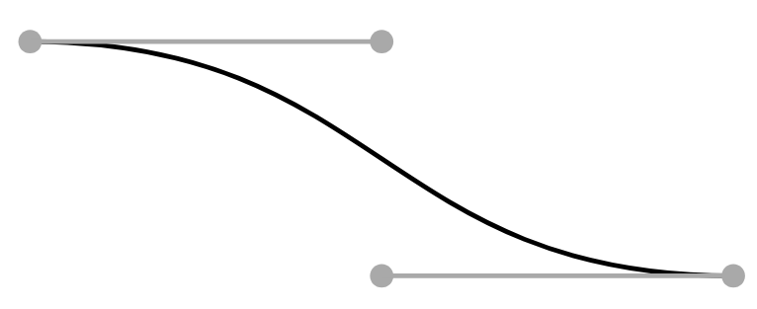
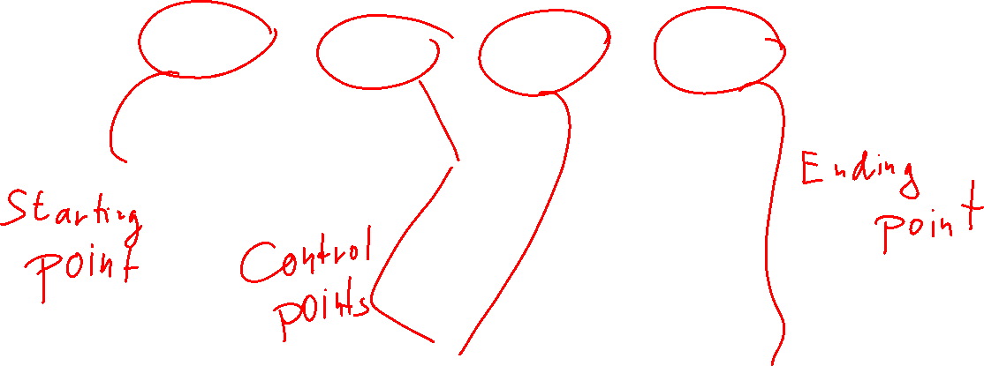
Cubic Bezier Curves
<path
d="M 200 100 C 350 100, 350 200, 500 200"
fill="none" stroke="black" stroke-width="2"/>

Slide 23
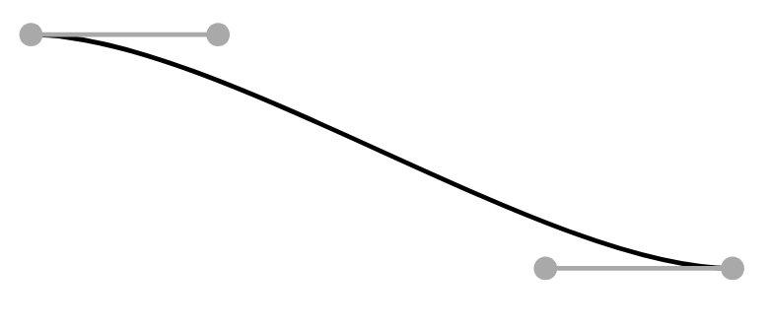
Control points (1)

Slide 24
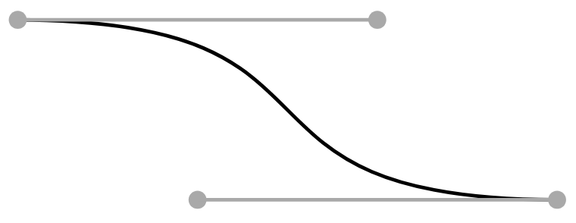
Control points (2)

Slide 25
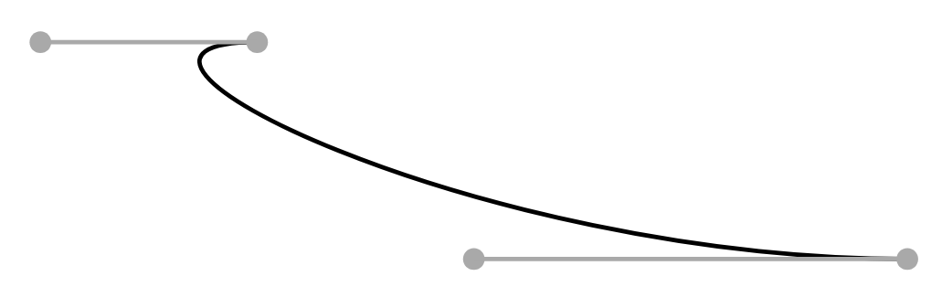
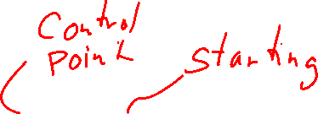
Control points (3)

Slide 26
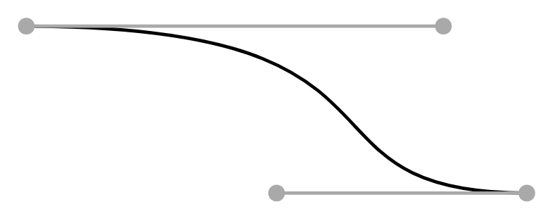
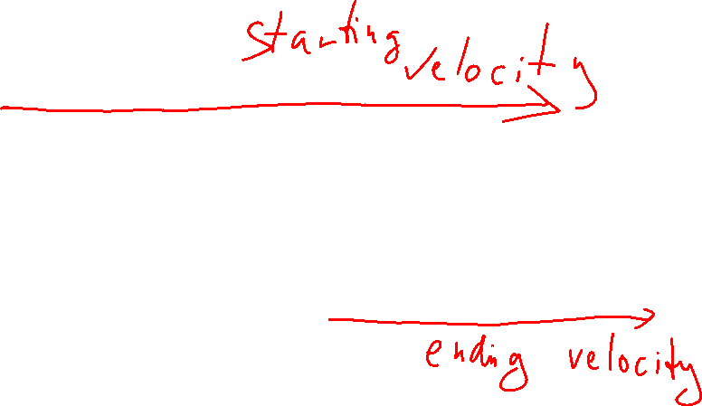
My Intuition

Slide 27
Demo

Slide 28
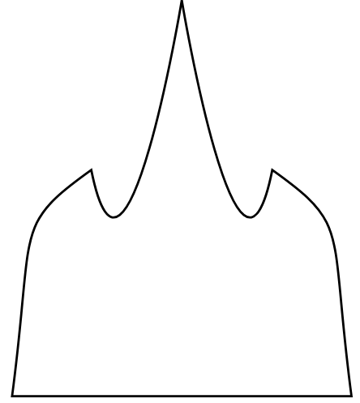

Break and exercise
Try to recreate the figure on the right using a single path
It probably won't be exact
I recommend VS code + Live Server plugin
Hints:
A path continues from where the previous section ended
z closes the path
It might be easier with relative coordinates (lower case c)

Slide 29
Agenda
Introducing the course
Introducing visualization
Introducing SVG
Introducing D3.js

Slide 30
D3.js
A library for
creating data-driven visualizations
updating data-driven visualizations
animating data-driven visualizations
Provides primitives for
Simple SVG elements
Complex groups of SVG elements (axis, diagrams, curves, trees)
Data loading
Data mapping to SVG
Interaction

Slide 31
Example (Fluent interface/method chaining/pipelining)
const svg = d3.select("svg")
svg.append("text")
.attr("x", 590)
.attr("y", 525)
.attr("font-size", 16)
.text("Systolic Pressure")

Slide 32
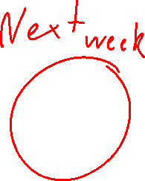
Working with data

Slide 33
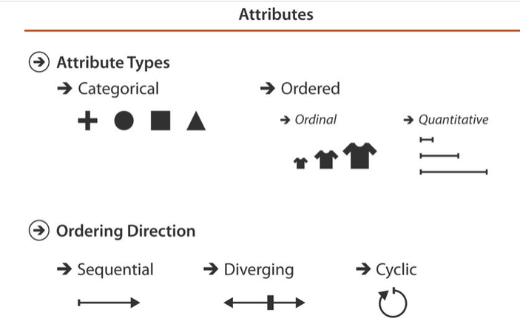
Finding: Types of data

Slide 34

Loading: Data formats
Format | Name | Example | d3-fetch function
CSV | Comma-separated Values | 88, 144, 819 | d3.csv()
TSV | Tab-separated Values | 88 144 819 | d3.tsv()
DSV | Delimiter-separated Values | 88; 144; 819 | d3.dsv()
JSON | JavaScript Object Notation | { "d": 88, "s": 144, "c": 819 } | d3.json()
Text |  |  | d3.text()
XML | Extendible Markup Language | <data> <d>88</d> <s>144</s> <c>819</c> </data> | d3.xml()

Slide 35
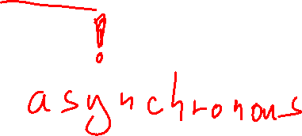
Loading: Example
const data = await d3.json("./data/bp.json")

Slide 36
Formatting (d3-format)
Normal data formatting
Formatting dates
Rounding
String formatting
String parsing

Slide 37
Formatting: Example
function format(data) {
…
}
d3.json(`data/${fileNameJSON}`).then(rawData => {
const formattedData = rawData.map(format)
return formattedData
})

Slide 38

Measuring
Getting an overview
Needed to understand the boundaries
Important for the scaling step
Measure
Number of elements
Min
Max
Inspecting the data is also measuring
Group elements and measure the data in the groups

Slide 39
Measuring: Example
const groups = d3.groups(d => d.day)
for([day, data] of groups) {
console.log(day)
console.log(d3.count(data))
console.log(d3.min(data, d => d.diastolic))
}

Slide 40
Scaling
Scaling is a mapping from data to displayed values
positions
colours
texts
…
It is used to display values consistently
It is mandatory for making things like axis on a scatterplot, and so on

Slide 41
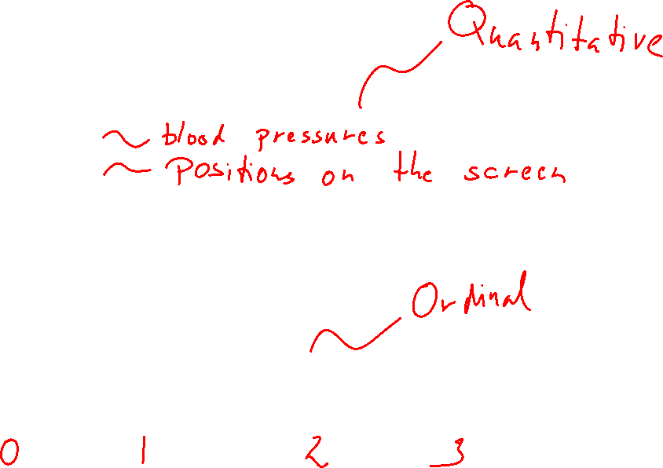
Scaling: Example
const systolicScale = d3.scaleLinear()
.domain([90, 160])
.range([100, 660])
const diastolicScale = d3.scaleLinear()
.domain([60, 110])
.range([500, 100])
const colorScale = d3.scaleLinear()
.domain([0, 3])
.range(["white", "lightgray", "darkgray", "gray"])

Slide 42
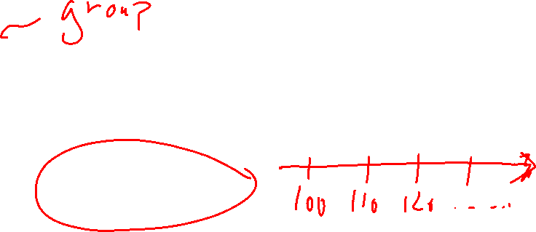
Scaling: Axis example
svg.append("g")
.attr("id", "horizontal-axis")
.attr("transform", "translate(0, 500)")
.call(
d3.axisBottom(systolicScale)
.tickSizeOuter(0)
.tickValues([100, 110, 120, 130, 140, 150]))

Slide 43
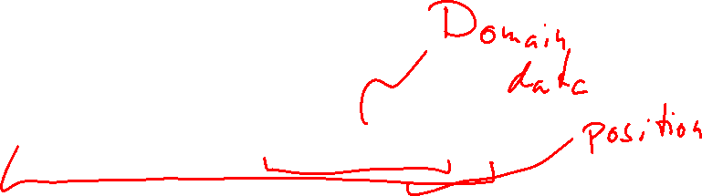
Scaling:
svg.append("circle")
.attr("cx", systolicScale(d.systolic))
.attr("cy", diastolicScale(d.diastolic))
.attr("r", countScale(d.count))
.attr("fill", colorScale(d.day))
.attr("stroke", "black")
.attr("stroke-width", 2)

Slide 44
Marks and Channels in D3.js
Marks
In visualization: points, lines (incl. curves), areas, (volumes)
In D3.js: SVG elements (circle, line, rect, …)
Channels
In visualization: positions on scales, lengths, areas, tilt, colour, shape
In D3.js: Scale + SVG element attribute
Exceptions exist (e.g. shape)

Slide 45
Demo
Notes:
Note: Optional

Slide 46
Binding
Making D3.js reactive to the data
Procedure:
Select some elements
Define the data
Join with the data - updates the elements to fit the data
Format the new (and old) elements

Slide 47
Binding: Example
svg.selectAll("circle")
.data(data)
.join("circle")
.attr("cx", d => systolicScale(d.systolic))
.attr("cy", d => diastolicScale(d.diastolic))
.attr("r", d => countScale(d.count))
.attr("fill", d => colorScale(d.day))
.attr("stroke", "black")
.attr("stroke-width", 2)

Slide 48
Demo and exercises

